Slide 1
Network-Accelerator Co-Design for Dynamic Inference of Natural Language Processing
宋玉红
2020.08.23

Slide 2
Pre-compression
Row & column pruning
Block size=100
Guaranteed accuracy
Select high-frequency pruning location
Shrink search space, this is the contribution of pre-compression
Confirm 10 patterns to be explored by reinforcement learning for every pruning number
Our concept: compression from a hot state

Slide 3
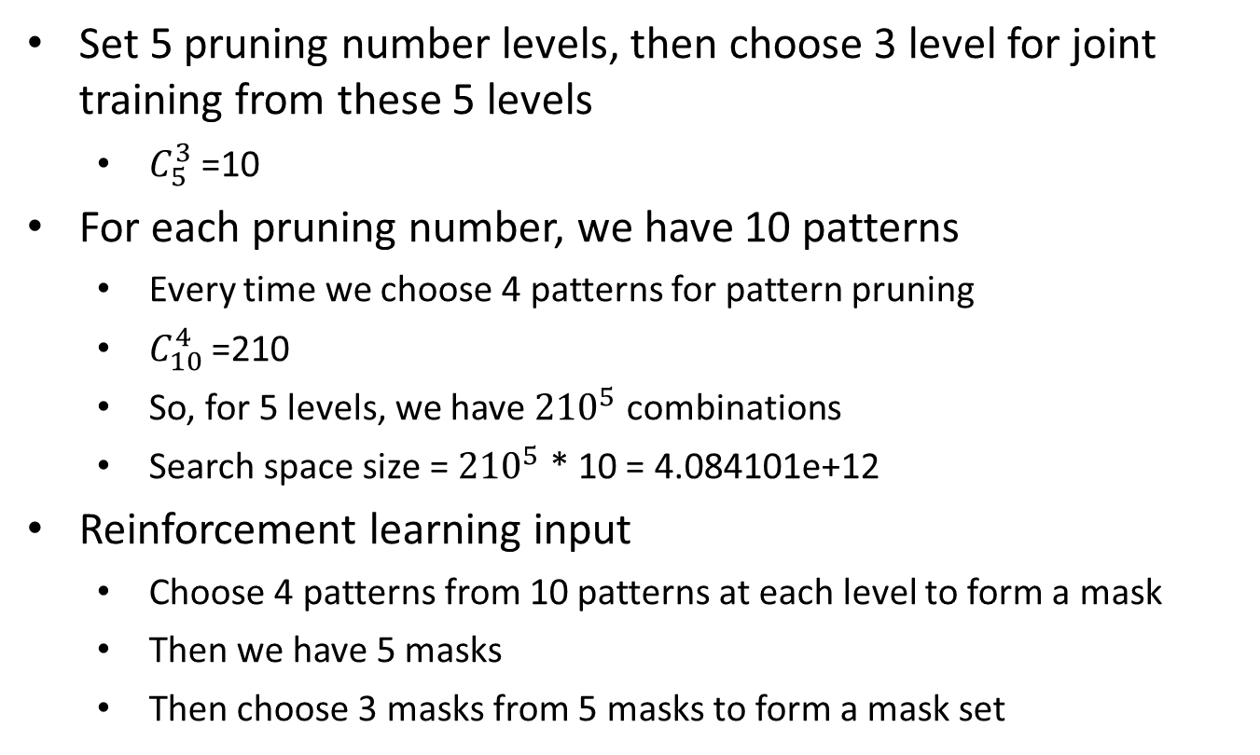
Search space
Set 5 pruning number levels, then choose 3 level for joint training from these 5 levels
$C_{5}^{3}$ =10
For each pruning number, we have 10 patterns
Every time we choose 4 patterns for pattern pruning
$C_{10}^{4}$ =210
So, for 5 levels, we have ${210}^{5}$ combinations
Search space size = ${210}^{5}$ * 10 = 4.084101e+12
Reinforcement learning input
Choose 4 patterns from 10 patterns at each level to form a mask
Then we have 5 masks
Then choose 3 masks from 5 masks to form a mask set

Slide 4
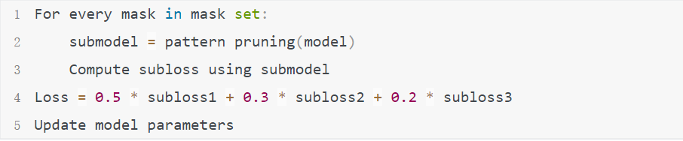
Joint training
Input: mask set
Joint training:
Contribution2:
Train for shared model to reduce storage cost in mobile device
Switch different levels easily for different scenario

Slide 5
Time consumption
Compute unit time
Use (1- time ratio) as time reward, for every pruning number
time ratio = computation time / non-pruning time
So higher pruning number, lower time ratio
Reinforcement learning reward
weighted accuracy = 0.5 * subaccuracy1 + 0.3 * subaccuracy2 + 0.2 * subaccuracy3
time reward
Contribution3:
We use time and accuracy to evaluate a shared model

Slide 6
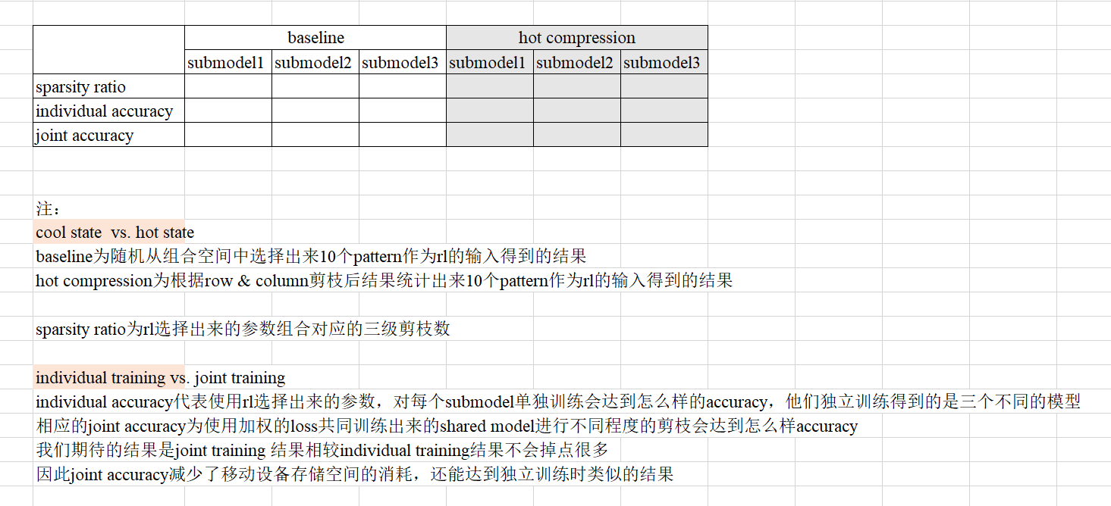
Experiment setting

Slide 7
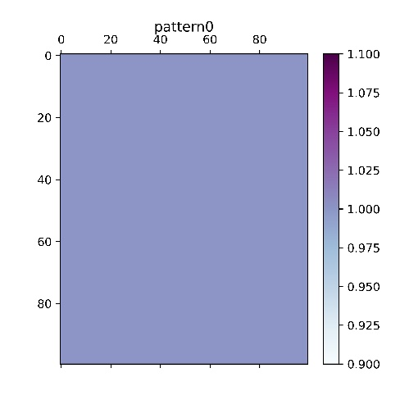
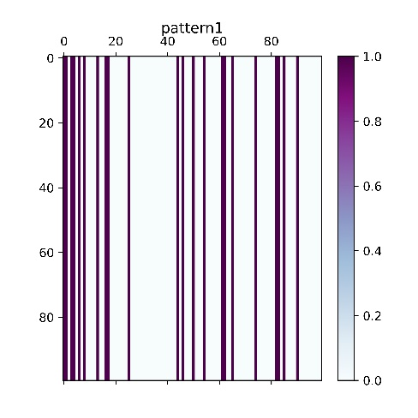
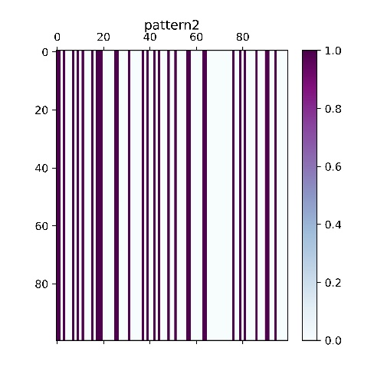
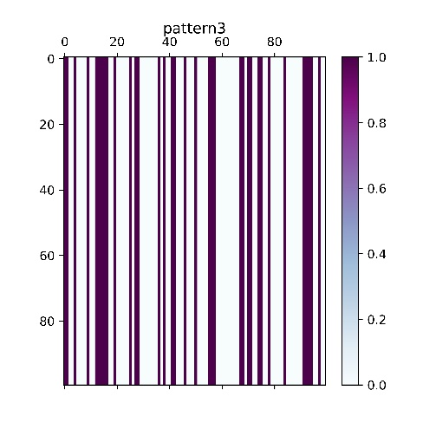
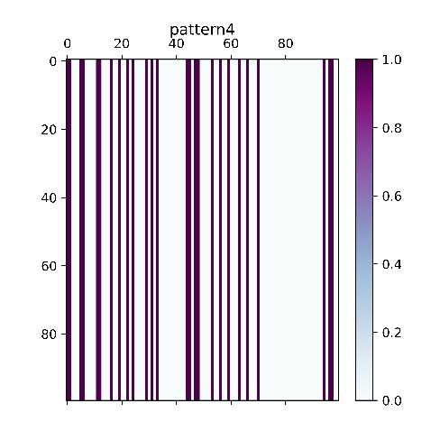
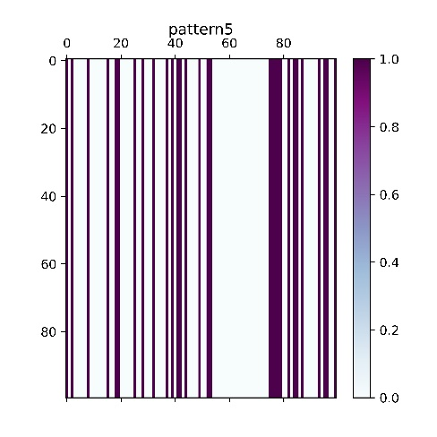
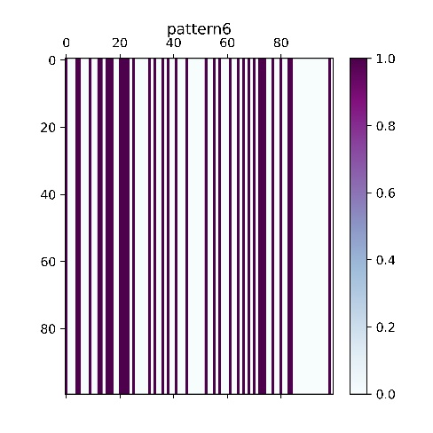
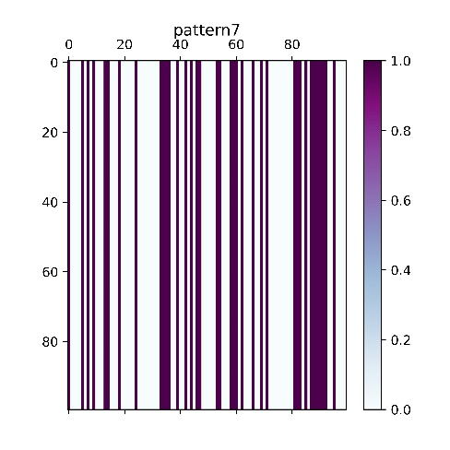
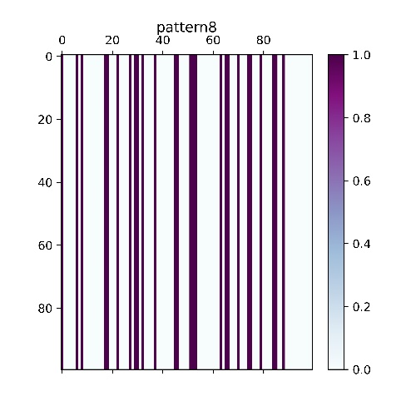
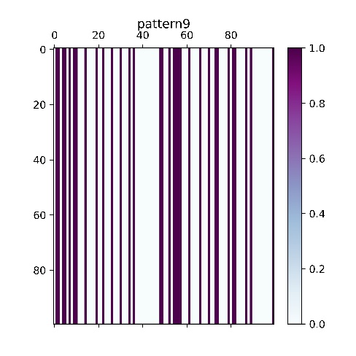
Model analysis

Slide 8
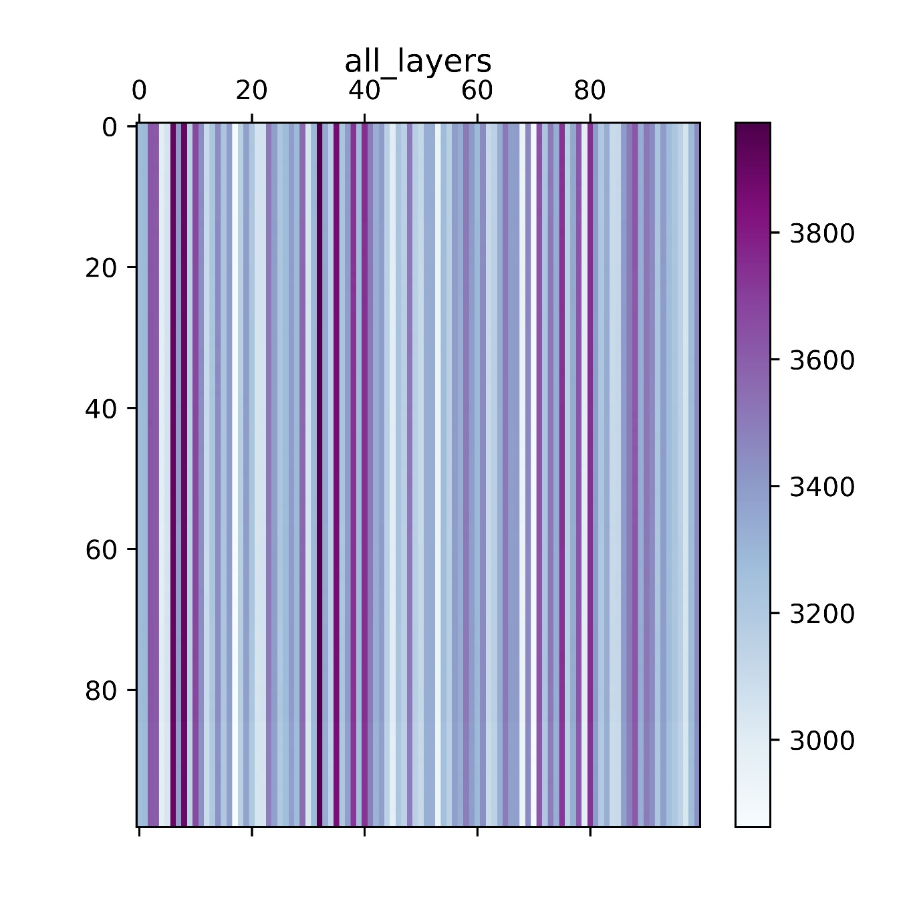
Model analysis
How to choose pattern?

Slide 9
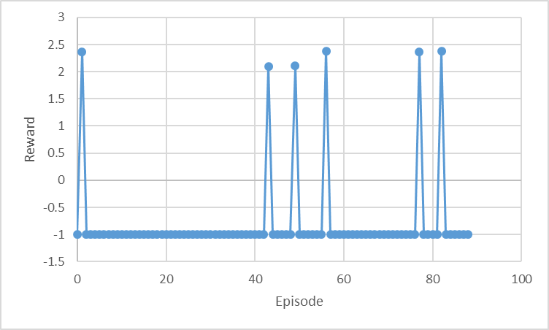
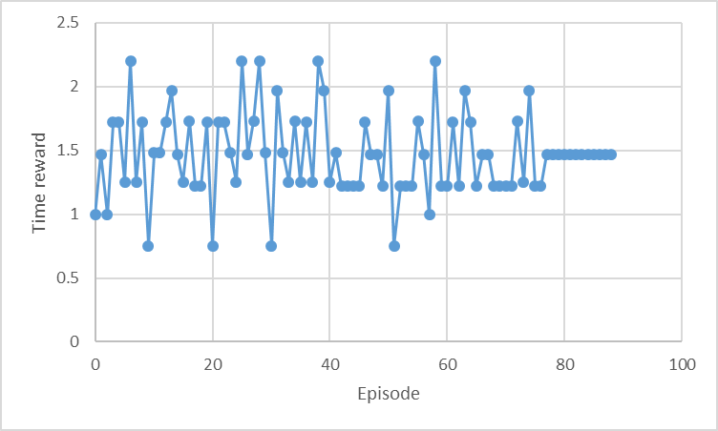
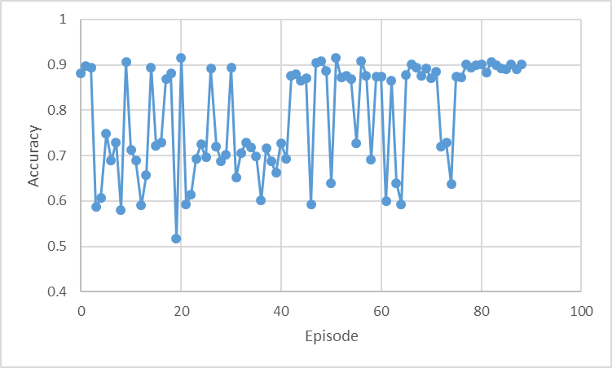
Model analysis

Slide 10
Explore loss weight

Slide 11
Explore loss weight

Slide 12
Explore loss weight

